Slide 1
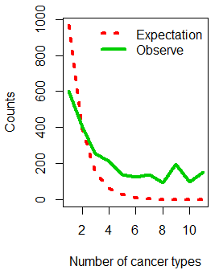
Methylation block conservation among 11 human normal tissues
2421 methylation block regions (59.97% in WGBS) were collected from 11 tissues. The probability of the number occurred in different tissues would be in a exponential decay as the red lines showed (P=0.4). However, we found a regions significantly deviate from the theoretical distribution (P<2.2 × 10⁻¹⁶,chi-square test) and therefore, the methylation block have strong conservation in different tissues.
Exponential decay
Conservation
P=length(blocks)/(length(uniqueblock)*event.time)
Notes:
Methylation block in human genome’s observation.

